Slide 1
Open Translators to Things
A new open source project @ www.github.com/openT2T
Alpha version on 4/5/16: Participation welcome!
Microsoft

Slide 2
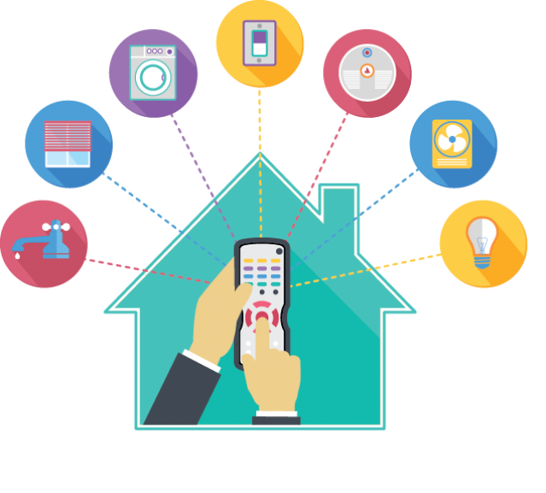
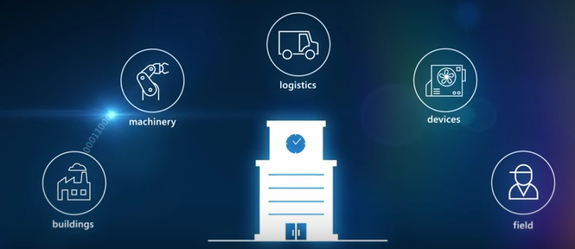
Consistent Experiences Delights Users and Developers
Interacting with a “Thing”
How do you turn on a Light? Do you need a different user experience for different manufacturers or when different Lights or Sensors use different protocols?
What is a “Thing” ?
What is a Thermostat? What is a Light-Switch? What are the minimum set of methods and properties shared by all Light-Switches? There are many competing industry answers today
The need for Schemas
Common “Schemas” describe the capabilities of similar devices, across protocols.
The need for Translators
Translators translate between common schemas and capabilities of actual Things
Home
Industry

Slide 3
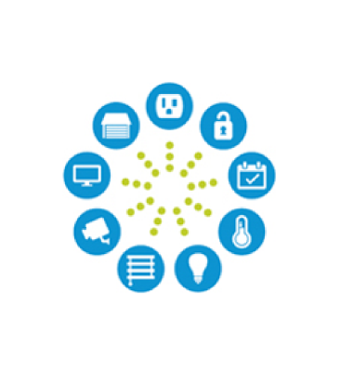

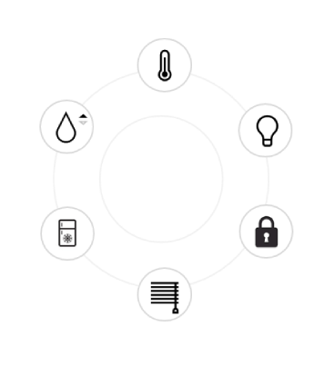
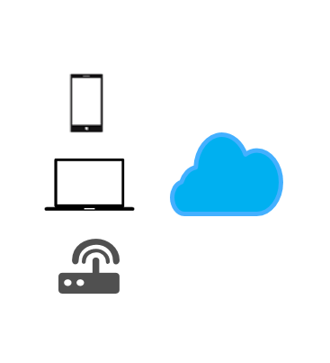
Open Translators to Things Pillars
Open
Schemas
Translators
Devices & Cloud
Open Source, supports Open Standards, Protocol Independent and Cross-Platform
Windows, OS X, Android, Azure and AWS supported initially
Other platforms will be added by the community, as long as the Translators work cross-platform
Schemas are created by the Industry, Standards Organizations or Open Source projects
Schemas are referenced by Translators
AllJoyn Schema syntax used initially
The Schema syntax will evolve to use one or more popular schema standards, including OCF
Developers create Translators from Schemas to similar Things
Supports JavaScript and Node.js initially
Developers use cross-platform Node libraries to access protocol buses
Other languages (e.g. C++, etc.) to be added by the community, as long as they access cross-platform networking libraries
Translators run on devices for proximally connected Things
Translators run on the cloud for cloud-connected Things
Translators run on Gateways for gateway-connected devices, marshalled from the cloud

Slide 4






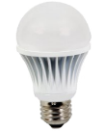
Translators can run on Devices, Gateways or Cloud
Translators can run on the Cloud for Cloud-connected Things
Translators run on Gateways for gateway-connected Things and marshalled from the Cloud
Lamp Schema
Translators run on devices for proximally connected Things
Lamp Schema
Translators
Lamp Schema
Translators
Translators

Slide 5
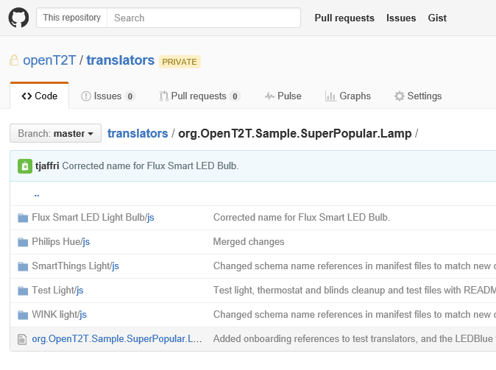
Contribute and build translators for your favorite Things for a consistent experience with Cortana, Consumer & Industry IoT Apps
www.github.com/openT2T
Pick a Schema Find a schema that corresponds to your Thing category - e.g. the “SuperPopular.Lamp” sample. It is best to use schemas created by standard bodies or schemas that are popular in the industry.
Write a Translator Write a Translator for your Thing, and send us a Pull Request. Create a folder with a unique product name that identifies your hardware. E.g. “Philips Hue”
Build Apps, Associate Voice Build a Device Cloud App that uses the schema you picked. Associate Cortana or other assistant to the schema. By using the schema, you will have a consistent experience with all other Things translated to the schema.
Make OpenT2T better
Contribute to the project, and discuss with the community. Participate in making the cli, translator, console, onboarding, debugging tools (and much more) better. Coordinate with other IoT projects.

